Slide 1



E-commerce Sales Dashboard
Axton Benedict Cahyadi

Slide 2

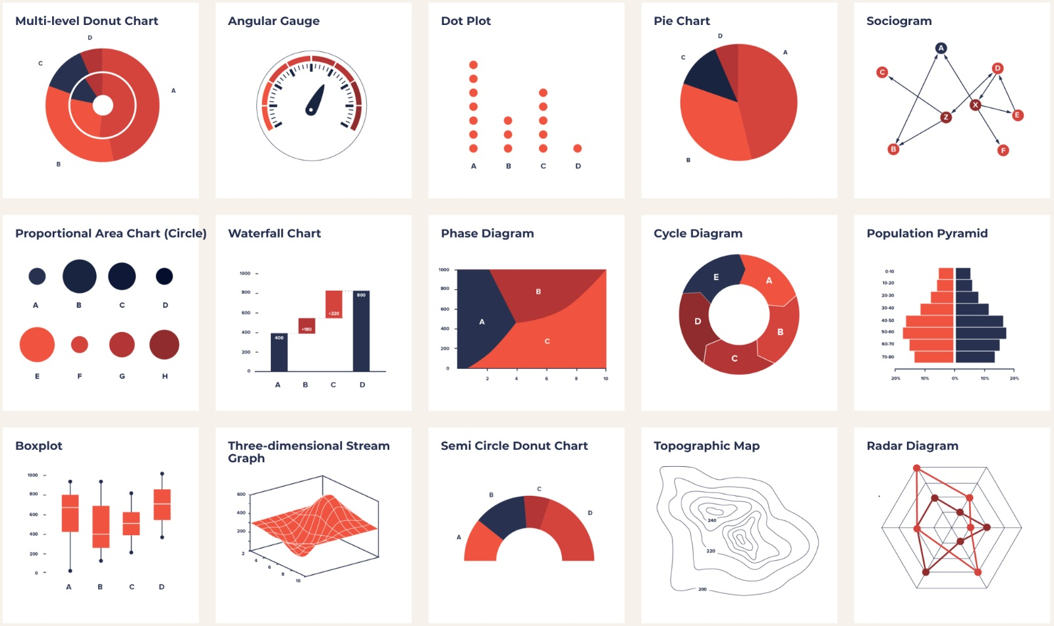


Project Objectives
Dashboard
Data analysis
Data visualization
Create a user-friendly dashboard on the Sales & Profit dataset given
Perform the appropriate analysis on the dataset and provide meaningful insights and visualizations of the dataset
Present conclusions, charts and insights based on the analysis to our stakeholders.

Slide 3
E-Commerce Dashboard dataset.xlsx
Dataset of year 2015
21 Columns and 51290 Rows
COLUMNS
Orders – details of each order
OrderID, Order Date and Ship Date
Aging
Ship Mode
Product Category & Products
Price details: Sales, Quantity, Discount, Profit, Shipping Cost and Order Priority
Customers – details of each customer
CustomerID, Name, Segment, Geographic details and months
Dataset Description

Slide 4



Data Formatting
Data Duplicates
Icon set rule
Data types
No duplicate records found for Customers & Orders
Showing profits & sales divided into 3 groups
Changing date format to dd-mmm-yy for readability

Slide 5

Analysis
STATISTICAL ANALYSIS:
Measures of central tendency such as Mean, Median, Max, Min to describe the typical value in the dataset
Measures of dispersion such as SD and Variance to indicate data spread
Find trends and correlation between variables for deeper insights
DESCRIPTIVE ANALYSIS:
Summarizing & interpreting data
Generate insights using statistics
Data Visualization using charts and graphs

Slide 6
Statistical Analysis
The average sale and profit is estimated to be $156 and $72
A 46% profit margin strongly indicates a healthy and profitable business
Although it has a high profit margin, there was an outlier of $0.5 profit only which needs to be looked into more and adjust discounts and shipping costs accordingly
Despite that, there wasn’t a sale that led to negative profit
High sales and profit variance is a concern as it suggests fluctuating revenue and could not produce stable results
Correlation between sales & profit is 92% which implies that as sales rise, so does profit
Metrics | Sales | Profit
Mean | $156.4 | $72.7
Median | $159 | $67
Maximum | $250 | $167.5
Minimum | $33 | $0.5
Standard Deviation | 67.8 | 49.1
Variance | 4327.1 | 2410.7
Correlation | 0.92
Profit Margin % | 46.5 %

Slide 7
Descriptive Analysis

Slide 8
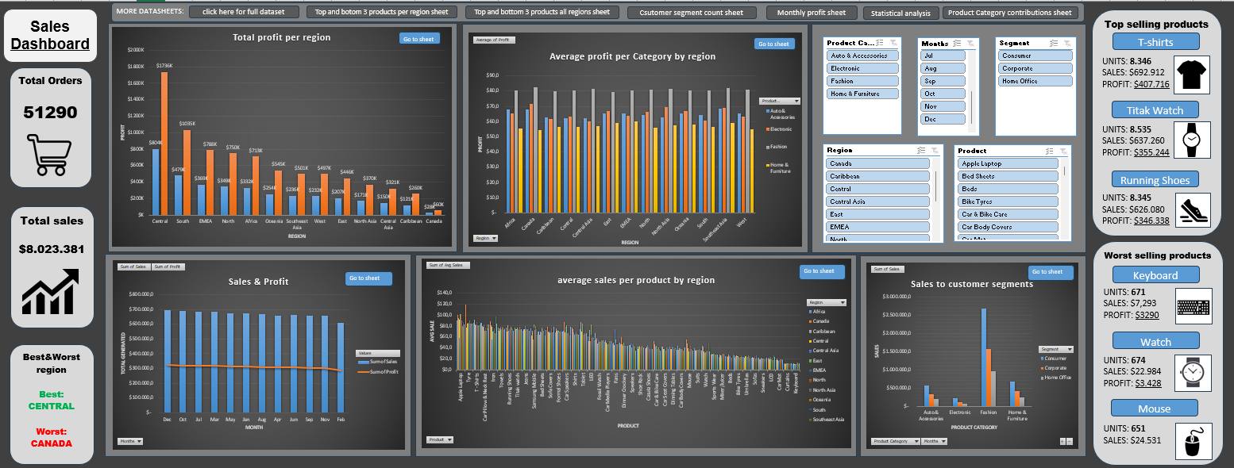

Slide 9
Sales & Profit
Averaging at:
SALES: $668.615
PROFIT: $301.825
Best performing month is December
Worst performing month is February
Both sales and profit lines are looking steady, which indicates a stable business.
December, October and July have the highest sales most likely due to holiday seasons / mid-year sales promotions
February has the lowest sales possibly due to fewer days of the month & post-holiday customer fatigue after spending too much in January

Slide 10
Profit per Product Category (region-wise)
All of the regions have a consistent average profit for all categories
Most profitable category is Fashion (green)
Least profitable category is Home & Furniture (purple)
Fashion dominating the product category with an average profit of $80 per order.
Home & Furniture coming in last by far with only $57 per order.
We can tell from here that Home & Furniture are not doing too well over all regions and need to improve marketing strategies and re-evaluate discounts to increase the profit margin.

Slide 11
Sales per product
(region wise)
Tyres in Canada
Iron in SE-Asia
Top 3 average sales
1.Apple Laptop
2.Tyre
3.T-shirts
Top 3 worst products
1.Keyboard
2.Curtains
3.Car Mat
Wide variance of sales by region
Invest more in the top 3 to capitalize on their strong market
Reconsider marketing/innovation approach to lowest 3 products
Products like Tyres in Canada and Iron in SouthEast Asia, hints at regional demand variations and should focus more on their demands appropriate regions

Slide 12
Best and Worst products
In both sales and profits category
Best products
1. T-shirts ($693k/$408k)
2. Titak watch ($647k/$355k)
3. Running Shoes ($626k/$346k)
Worst products
1. Keyboard ($25k/$5k)
2. Watch ($23l/$3k)
3. Mouse ($7k/$3k)
NOTE: <product><total-sales/total-profit>
THIS IS FOR ALL REGIONS

Slide 13
Customer segment sales
It shows that more than 50% are Consumers
Home Office have the least sales as shipping cost and sales correlate the same way
All customer segments indulge in the Fashion category the most and Electronics last.

Slide 14
Product contribution sales
Most of the sales (65%) are in Fashion (green)
Smallest sales category is in Electronics (5%) (red)
With Auto & Accessories and Home & Furniture closely tied at 14% and 16% respectively
Look into stocking more inventory on fashion as it is the leading category
Investigate and change products sold in the Electronics category to keep up to date with the trendy items

Slide 15
Conclusion

Slide 16
Sales Trends: December with highest profit and sales with February being the lowest
Regional Performance: Central takes the top spot with both sales and profit with Canada in last place
Product & Category Insights: T-shirts, Titak Watches and Running Shoes taking top 3 in profits while Keyboards, Watch and Mouse in last places, but still having positive profit. Fashion category is where most customers order from and Electronics category are rough that year.
Customer Segments: Consumers drive the most sales and quantity sold with Home office last place.
Profitability & Trends

Slide 17
Most & Least profitable products (½)
Most
Central
South
EMEA
North
Africa
Oceania
SE-Asia
T-shirts
Titak Watch
Running Shoes
T-shirts
Titak Watch
Running Shoes
T-shirts
Titak Watch
Jeans
T-shirts
Titak Watch
Running Shoes
T-shirts
Titak Watch
Running Shoes
T-shirts
Running Shoes
Jeans
T-shirts
Titak Watch
Jeans
Keyboard
Watch
Mixer / Juicer
Keyboard
Watch
Mouse
Keyboard
Watch
Mouse
Keyboard
Watch
Mouse
Keyboard
Watch
Mouse
Keyboard
Watch
LCD
Keyboard
Watch
Mixer / Juicer
Least

Slide 18
Most & Least profitable products (½)
Most
West
East
North-Asia
Central-Asia
Carribean
Canada
T-shirts
Titak Watch
Running Shoes
T-shirts
Titak Watch
Running Shoes
T-shirts
Titak Watch
Jeans
T-shirts
Titak Watch
Running Shoes
T-shirts
Jeans
Running Shoes
T-shirts
Titak Watch
Jeans
Keyboard
Watch
Mouse
Keyboard
LCD
Mixer / Juicer
Keyboard
Watch
Mixer / Juicer
Keyboard
Watch
Mouse
Keyboard
LCD
Mouse
LCD
Mouse
Mixer / Juicer
Least

Slide 19
Insights & Recommendation

Slide 20
Sales Strategy:
Increase marketing and promotions in Q1 (especially Feb) to boost sales
Stock up on inventory and plan ad campaigns for December to maximize sales
Regional Focus:
Expand operations and marketing in Central region to capitalize on strong performance
Analyze challenges in Canada’s market and refine marketing efforts and strategies
Product Strategy:
Invest more in high performing categories such as Fashion which includes T-shirts, Running shoes and Titak watches which are the top 3 best selling products as well
Consider product innovation to boost weaker categories like Electronics, which includes Keyboards and mouse products
Customer Segmentation:
Segments customers further for deeper insights and better marketing strategy
Bundling home office essentials, more discounts and awareness campaigns to increase demand
Profitability & Trends

Slide 21


Thank you
axtoncahyadi@gmail.com
http://www.linkedin.com/in/axton-cahyadi-378115233

